Slide 1
Bank Accounting

Slide 2
Contents
Purpose
Uses
Challenges
Requirement: Bank Account Structure
Bank Master Data
Check Management
Bank Statement

Slide 3
Purpose
This component is used to handle accounting transactions that you process with your bank
It includes the management of bank master data, cash balance management (check and bill of exchange management), and the creation and processing of incoming and outgoing payments
It is possible to freely define all country-specific characteristics, such as the specifications for manual and electronic payment procedures, payment forms, or data media

Slide 4
Use
Bank Accounting Functions:
The Bank Accounting enables in effective and efficient cash management
The incoming and outgoing payments are posted to clear customer / vendor open items. Enables to keep track of checks issued, check received. Enables to update the checks to be deposited to Bank by clearing customer open items, pending clearing of check by payment. The lockbox statement for payment by customer will be uploaded automatically to clear the appropriate customer open items
Enables to upload the Bank statements manually / automatically so as to update the Bank account immediately on receipt of statements. This will ensure the Bank reconciliation immediately on receipt of Bank statement

Slide 5
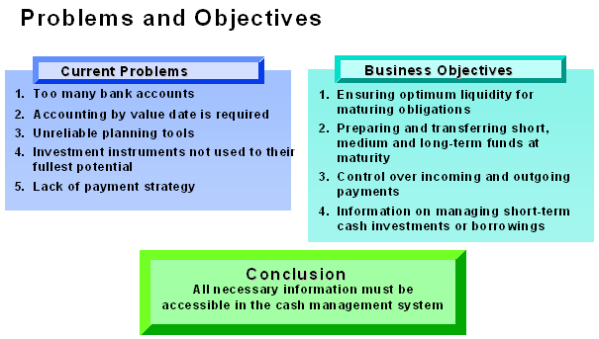
Challenges

Slide 6
Requirements: Bank Account Structure

Slide 7
Requirements: Bank Account Structure
Bank Accounting is to provide a bank (current) account for each currency and, in each case, a clearing account, on a lower level and per processing type
You can tailor the clearing accounts to the need of your business
Objectives:
Accounts can be reconciled any time
Foreign currency and local currency are managed in parallel
Can be managed by value date
Interest can be calculated
Line item analysis possible
Contingent liabilities can be monitored
Items posted automatically using automatic payment transactions
Automatic breakdown using electronic banking transactions
Only transactions which are, according to the bank statement, active are posted in bank accounts

Slide 8
Requirement I: Bank-Related Accounting

Slide 9
Requirements: Bank Account Structure
Processing sequence
You need to create the GL account for each active account, you have at bank by currency if applicable. In addition, you need to create bank clearing accounts for each bank account, also by currency if applicable. In this connection, the following grouping is recommended:
113100 Bank 1 (current account – domestic – currency INR)
113101 Bank 1 (Outgoing Checks)
113102 Bank1 (Outgoing bank transfer, domestic)
113103 Bank1 (Outgoing bank transfer, foreign)
113104 Bank 1 (automatic Deposit)
113105 Bank1 (miscellaneous interim postings)
113108 Bank1 (incoming checks)
113109 Bank 1 (customer cash receipts)
Payment transactions: Are posted against the clearing accounts using the payment program
Bank statements: Balance the clearing entries against the bank account
Cash Management: Displays or monitors postings, with the help of various groupings

Slide 10
Requirement II: Bank Accounts

Slide 11
Bank Master Data

Slide 12
Bank Master Data
Every bank which is used in the system (e.g. as a house bank or as a customer/vendor bank) needs to have a bank master record
Bank master records are stored centrally in the bank directory. Every record is identified by the bank land and the bank key. Bank master records include bank address data and control data such as the SWIFT Code, postal giro data, and bank group (for payment optimization)
Bank master data can be created in two different ways:
Manually Bank master data can be created with a special transaction when entering bank details of customers/vendors, or when entering a document for a one-time customer/vendor.
Automatically The bank directory can be imported from disk or tape using a special program. The disk with the bank directory can be obtained from one of the country's banking organizations. It should be updated regularly.
After bank master data is created, some banks can be defined as the enterprise's house banks. House banks are identified by a house bank-ID
Bank details in the customer/vendor accounts also refer to the bank master data. Each bank detail is identified by the field ”bank type”
The house bank-IDs and the bank types can be used by the payment program to determine the banks to be used

Slide 13
House Bank

Slide 14
House Bank
Bank accounts that are managed by house banks have to be defined as well. The accounts can be identified by an account-ID which is unique per house bank. The bank account data contains the number of the account at your bank, the account currency and the G/L account which reflects the postings on your bank account in the general ledger
For every bank account a G/L account must be created. This G/L account is assigned to the bank account and vice versa. Both accounts have to have the same account currency

Slide 15
Bank Accounts

Slide 16
Bank Accounts
The company code bank accounts are stored under an account ID for the house banks that you define
A G/L master record is created for each bank account
You can store the house bank key and account ID in the bank account master record
If you maintain currency accounts, the currency key in the G/L master record must be the same as the foreign exchange of the currency account
During bank correspondence, the system uses the bank ID and account ID to obtain the address information from the bank directory
In SAP ECC system each house bank of a company code is represented by a bank ID. The House bank is used for automatic payment program, check deposit, bank reconciliation. Thus only house bank needs to be created for a bank account if the aforesaid functionality has to be used. For all this to be possible, the bank needs to be defined as a House in the SAP
In SAP S/4HANA the bank account number for House bank can be maintained in Net weaver business Client

Slide 17
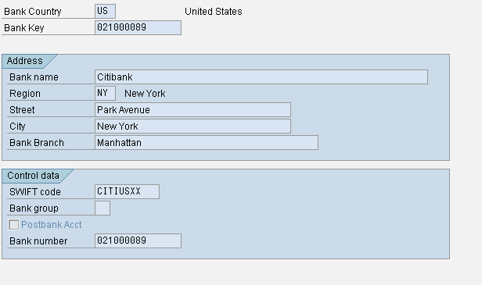
Creating Bank Master Record [FI01]
Menu Path: SAP Menu ➔ Accounting ➔Financial Accounting ➔ Banks ➔ Bank Master Record ➔ Create.
Give the Bank Country and Bank Key [Unique Key under which the Bank data for the country is stored]. In the next screen enter the Address and Control data.
Swift Code: Uniquely identifies the bank for international payment transactions.
Bank Group: Serves to classify the banks in such a way that payment transactions within a group are processed as quickly as possible.
Bank Number: The Banks are managed normally using their unique bank number for the country. In such case this field for the bank is displayed twice, that is, as the bank key too.

Slide 18
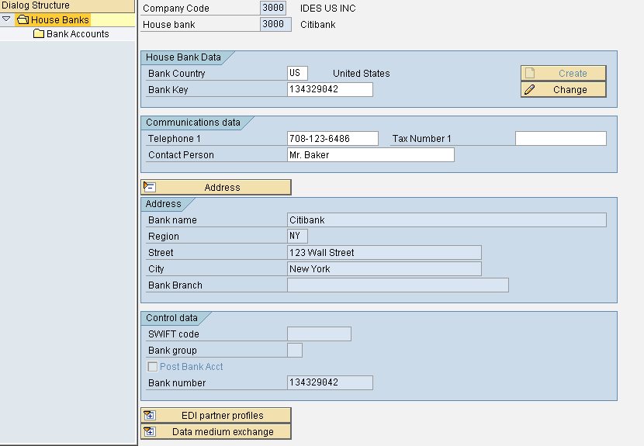
Define House Bank [FI12]
Menu Path: IMG ➔ Financial accounting (New) ➔ Bank accounting ➔ Bank Accounts ➔ Define house Banks.
Give the company code. In the next screen click on new entries.
In the next screen give the name for the House Bank. Once the Bank country and bank key are given, the address details will be captured from bank master data.
Enter the communication data. EDI partner profiles and data medium exchange sections are optional and need to be maintained if this house bank transactions are processed using them.

Slide 19
Define House Bank [FI12_HBANK]
Menu Path: IMG ➔ Financial accounting (New) ➔ Bank accounting ➔ Bank Accounts ➔ Define house Banks.
Give the company code. In the next screen click on new entries.
In the next screen give the name for the House Bank. Once the Bank country and bank key are given, the address details will be captured from bank master data.
Enter the communication data. EDI partner profiles and data medium exchange sections are optional and need to be maintained if this house bank transactions are processed using them.

Slide 20
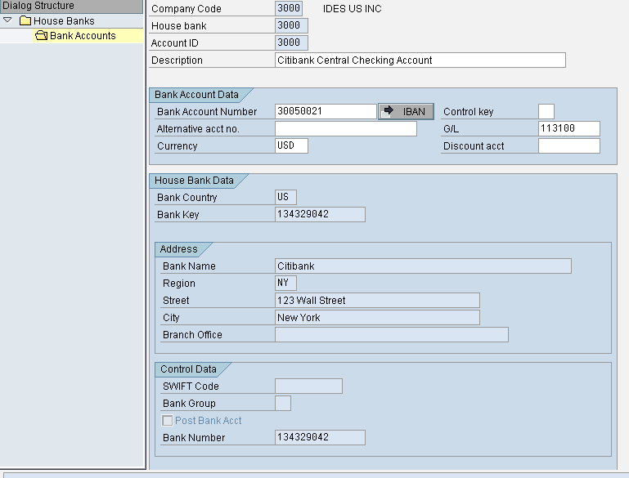
Adding Bank Accounts to House Bank
In the same screen, select the house bank and click on Bank accounts. Click on new entries
In the next screen give the Account ID, description, bank account number, control account [refers to account type by default 01 i.e. checking account], corresponding GL account, currency of the bank account. All other details are picked from bank master data
We can add number of different bank accounts to the House Bank as in real scenario the companies maintain number of bank accounts in a bank branch

Slide 21
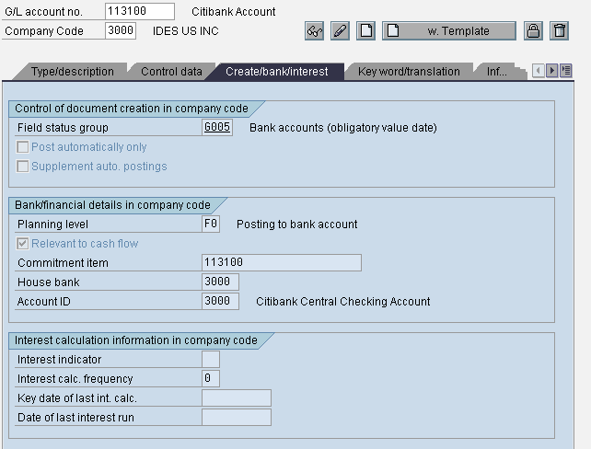
GL Account Master Data for Bank Account

Slide 22
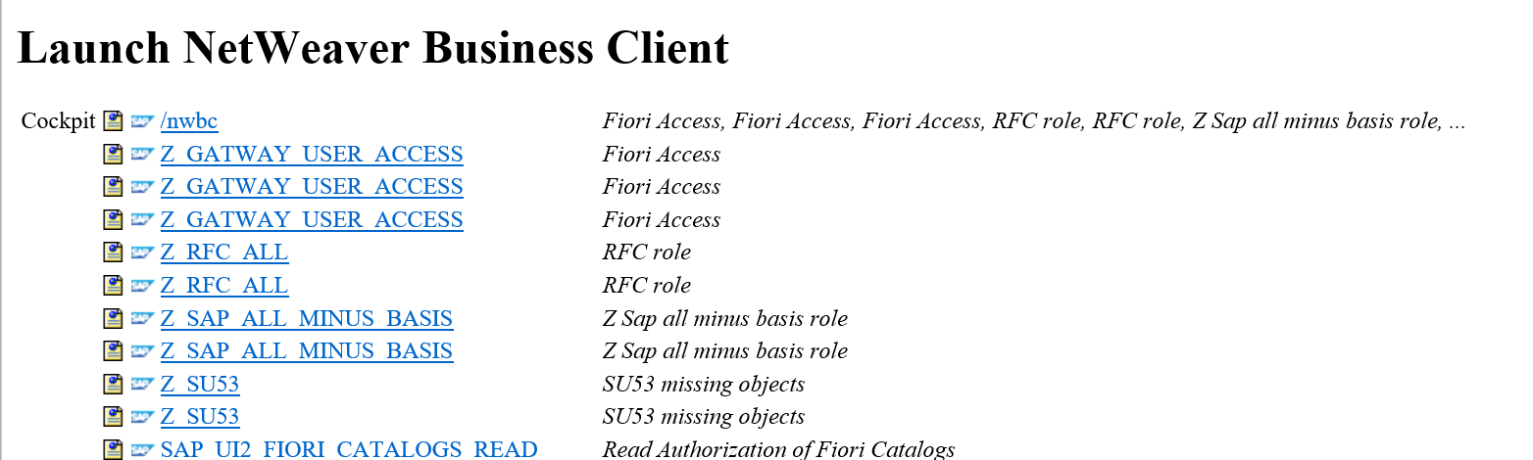
Creating Bank Account via T-Code: NWBC (Net Viewer Business Client)
After you are done with House bank creation (Via T-Code: FI12_HBANK), the next step is to create the bank account in NWBC and assign account ID to this bank.
Please ensure that you have following roles in NWBC to perform this activity. Ask your security team to assign these roles to your profile
SAP_FI_BL_BANK_MASTER_DATA
SAP_SFIN_CASH MANAGER
Execute transaction code: NWBC and it will take to Web Browser

Slide 23
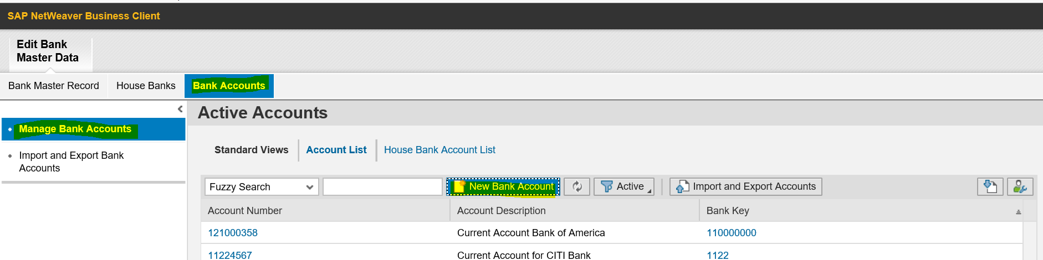
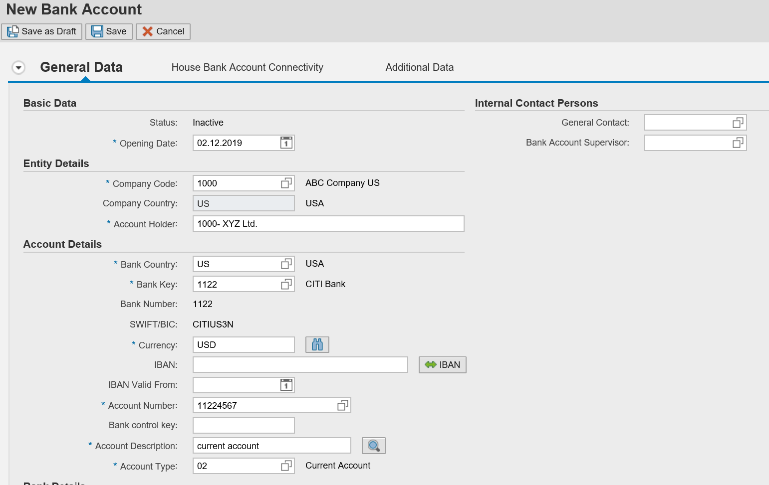
Creating Bank Account via T-Code: NWBC (Net Viewer Business Client)
Click on Edit Bank Master Data
Click on Bank Accounts
Click on New Bank Account
Enter the bank details as per your business requirement
Click on “Save ”
Click on “House Bank Account Connectivity”
Click on “Edit” Button
Click On “Add” Button
In the Subsequent screen, enter “House Bank Account” and “G/L Account”
Click on “Save” button to save the entered data

Slide 24
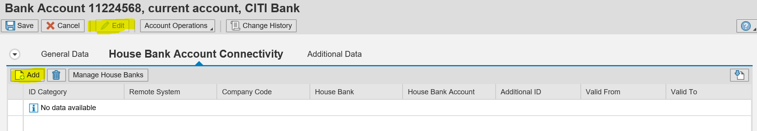
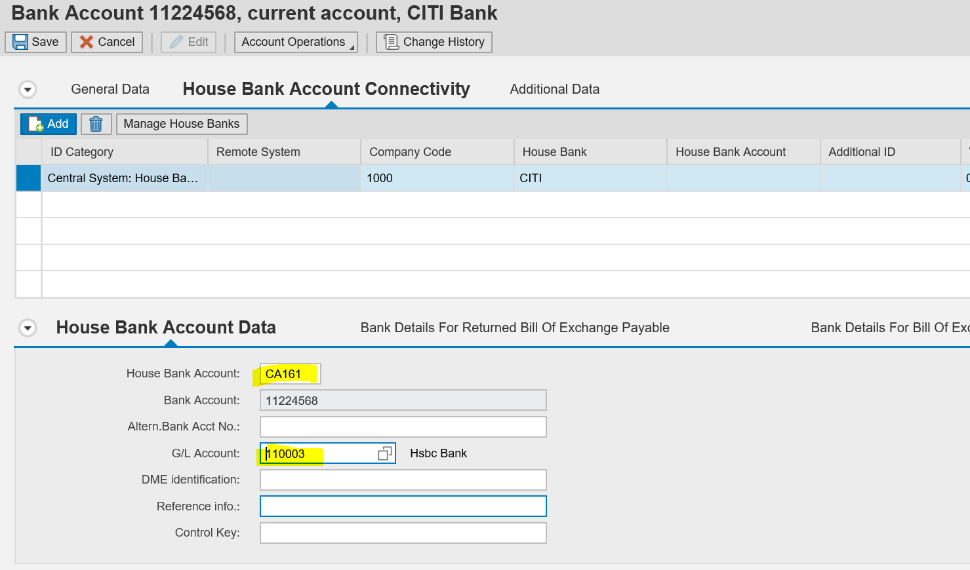
Creating Bank Account via T-Code: NWBC (Net Viewer Business Client)
Click on “Edit” Button
Click On “Add” Button
In the Subsequent screen, enter “House Bank Account” and “G/L Account”
Click on “Save” button to save the entered data

Slide 25
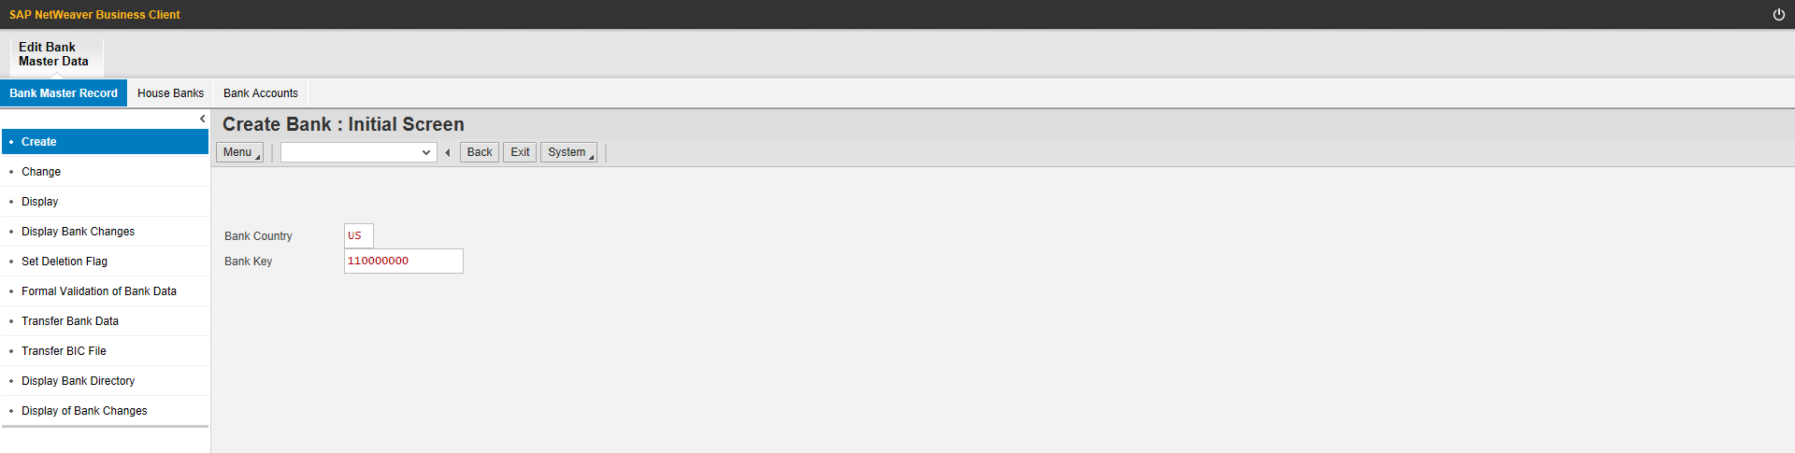
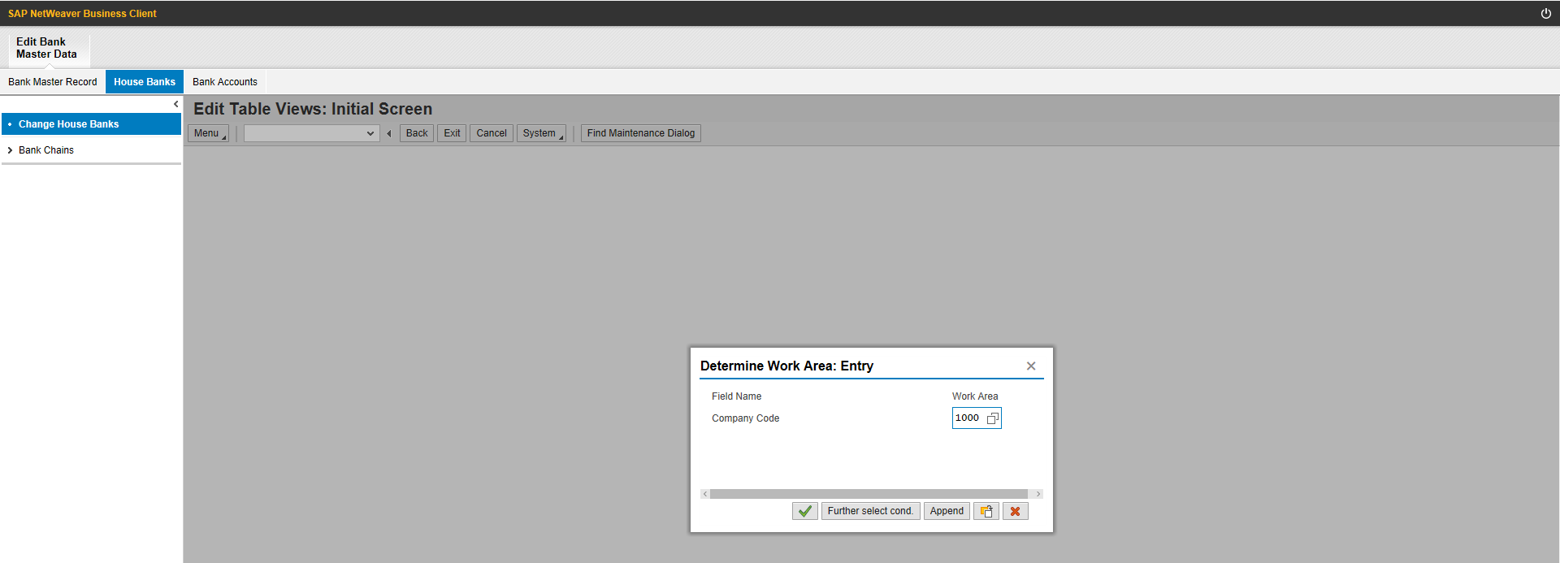
Manage Bank
1. Bank Country
2. Bank Key
3. House Banks
4. Company Code

Slide 26
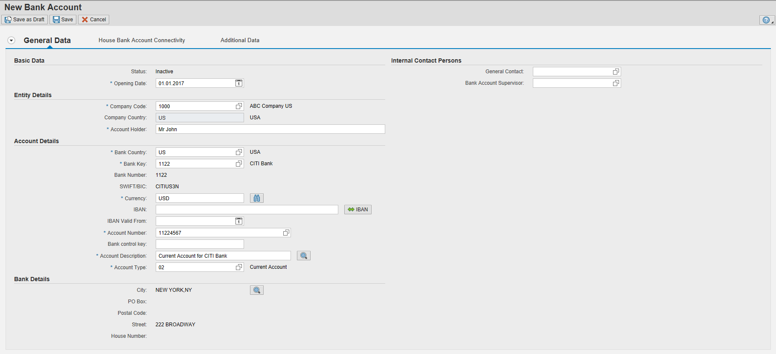
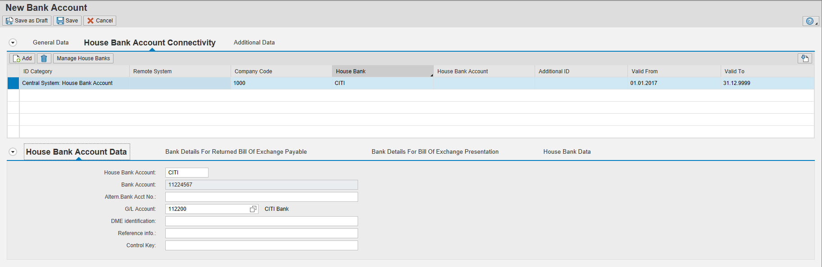
Manage Bank
5. Opening Date
6. Company Code
8. Bank Key
7. Bank Country
9. Currency
10. Account Number
11. Account Type
15. Click Save
12. House Bank Account
13. Account Number
14. Enter GL account

Slide 27
Check Management
The Check Management system can be used as an alternative method for issuing checks, if you do not wish to use the R/3 document number as the check number
The system provides the functionality to support the management for both pre-numbered checks and user defined check numbering
The system provides the mechanisms for control the printing of checks, the displaying of check information and the ability to rectify any problems with the checks

Slide 28
Check Management Functions
The check number controls the number range of a batch of checks
Unusable checks may be voided
Checks may be printed by lot or individually online
The system provides recovery to printing problems
Manual checks can be entered
Information concerning the checks may be displayed
Checks cashed at the bank can be recorded electronically or manually

Slide 29
Check Number Management
Pre-numbered checks are checks that have had the number issued by the bank
It is assumed that the checks are supplied by the bank or printers in batches
These batches have a range of numbers and within in SAP, this number range is defined as a check lot
The print program uses this lot to make the link between the check and the payment
When you create a lot in SAP, it has the following entities:
A short description for identification
The number at the start of the batch
The number at the end of the batch
The number that was last printed
The lot is allocated to the house bank which issued the checks and is assigned to the check account within the house bank
The length of the check number is explicitly determined when the lot is defined and if the number is too short you may retroactively extend the number by running the program, RFCHKR00

Slide 30
Check Void Reasons

Slide 31
Check Void Reasons
In the issuing of pre-numbered checks, a number of checks may be come unused for a number of reasons. These checks must be made void in the system
When voiding a check, a reason must be given and this reason is defined as a code
The system has reasons issued exclusively by the print program:
Test print
Page overflow
Form closing section
You may define as many reasons as you may require
You can void checks before and after the checks have been printed
Checks that are deleted before the print run, for example, are blanks checks that are accidentally damaged, or stolen, or rendered unusable for any other reason
Checks that are deleted after the print run, for example, are printed checks not required as cash was paid, or printer damaged checks
Checks that were voided in error, may be reset to their original status

Slide 32
Check Printing
Checks may be printed by lot
You enter the check lot number as a parameter to the print program
When running, the print program determines the next check number from the lot and pairs the check number with the payment document number
The check register file records the data resulting from the run
Checks may be printed individually rather than by lot
You may clear the outgoing payment and print the check simultaneously
You may clear the outgoing payment and print the check later

Slide 33
Manual Checks
Checks issued by hand need to be dealt with separately in order to create the link between the check number and the payment document number
The outgoing payment is made and the payment document number is then allocated to the check number
It is recommended to reserve a separate number range for manual checks
Manual checks incorrectly entered by be corrected by resetting the cleared items and deleting the cashing data

Slide 34
Check Printing Problems
The check management system provides functionality to rectify any problem that may occur when printing.
Some example of problems that may occur:
In correct check lot in the printer
Check loaded into the printer in wrong order
Defective printer or paper jam
Check unusable before printing
Printed check is lost
System crash during print run

Slide 35
Check Deposit: Procedure

Slide 36
Account Assignment
Session 1: Postings to bank accounts (clearing accounts)
Session 2: Postings to subledger accounts (customer account clearing)
Bank statement: Bank account postings (clearing items in clearing accounts)

Slide 37
Check Deposit: Initial Specifications
The start variant specifies the account assignment variant for the individual postings
If you select internal bank determination, the system identifies the bank using the internal name instead of the bank number and external account number
The matchcode ID D and the contents of the customer matchcode field on the next screen make up the matchcode of the customer account the system searches for (account determination for payment settlement)
The further processing type determines whether the postings in the batch input session are made online or in the background
If you select the Transfer value date option, the value date you specify when entering the checks is transferred to the postings
Specify a form ID if you want to use a form that differs from the standard form for the check deposit list

Slide 38
Check Deposit Transaction: Entry Screen
Group: Freely definable term that differentiates various check deposit lists (for example, by bank account)
Transaction: Controls how and to which accounts the items are posted. User-definable description (customizing)
Posting date: Of the documents for posting
Value date: The expected value date in the bank statement (can be transferred to the documents for posting)
Note: A separate list should be created for each currency (or value date) due to the various methods in fixing value dates.

Slide 39
Check Deposit List
The account assignment variants (start variants) determine which fields are displayed during entry
You can define the variants as you want in customizing
You can change variants during entry
For some fields (document number, invoice amount), you can enter as many values as required

Slide 40
Check Deposit: Posting / Printing / Overview
The Post option generates the batch input sessions with postings for the bank accounts and sub ledger accounts Note: The session with bank postings should be generated and processed first due to system processing and performance (cash management position)
The Print option allows you to display the form for printing

Slide 41
Generating the Postings
You can process the sessions individually or together, online or in the background (batch)
The log displays the processing statistics and any incorrect transactions
You can reprocess incorrect transactions. You then have to process the batch input session again online

Slide 42
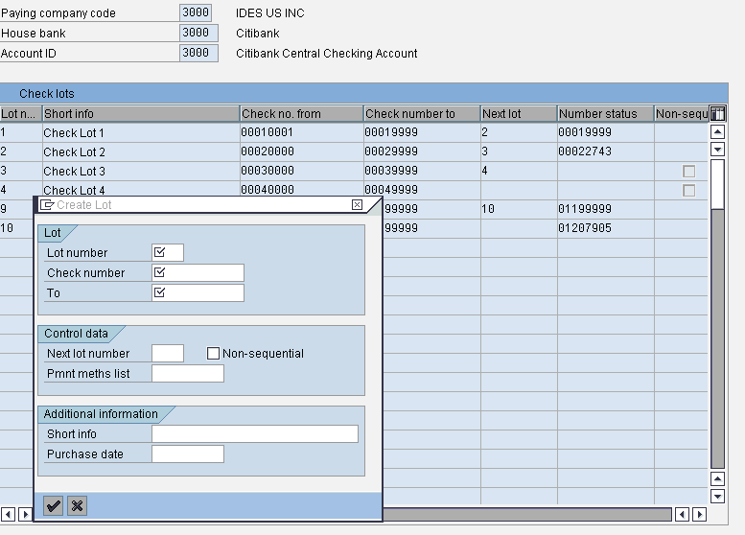
Check Management – Configuration
Define Number ranges [FCHI]:
Menu path: IMG ➔ Financial Accounting(New)➔ Accounts receivable & accounts payable ➔ Business transactions ➔ Outgoing payment ➔ automatic outgoing payment ➔ Payment media ➔ Check management ➔ define number ranges for checks
Give the company code, house bank and account id. Click on change button. In the next screen click on the create button
Enter the required details of the check lot. Next lot number is for sequence of check lots. Payment method list is to limit the payment methods for the check lot

Slide 43
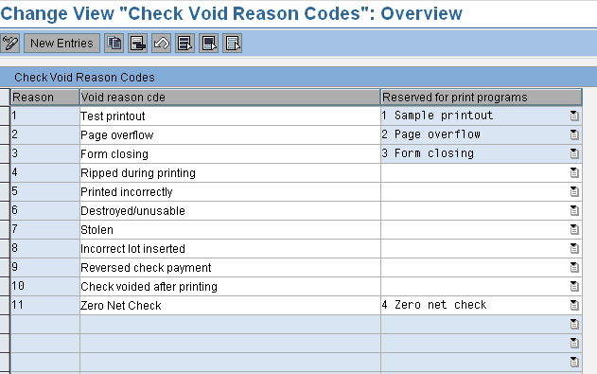
Define Void Reason Codes
Here we define void reason codes for pre-numbered checks. The checks should be marked as voided if they are made invalid for some mistake, if they were stolen or if they were made void due to other reasons. To do this we specify the reason for voiding the check.

Slide 44
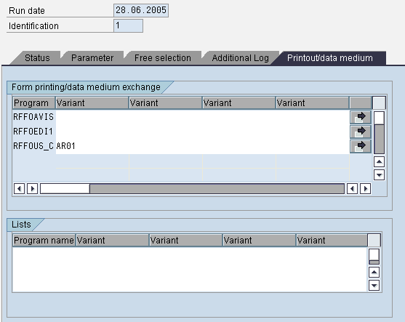
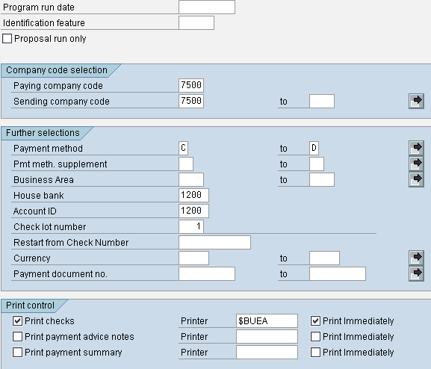
Program Run
You enter the check lot number as a parameter for the print program RFFOUS_C or define an appropriate variant for this program. The check print program determines the next free check number and stores the assignment of payment document number to check number or of check number to payroll results (in the case of payment runs in Human Resources (HR))
A next lot can be entered in Interval Maintenance. The print program is then able to determine which check lot is to be printed next. This means that you do not have to change the variant when a check lot is used up
The check register file records the data resulting from the print run, and the check number status is updated automatically by the print program

Slide 45
Printing Checks Online
As well as printing checks by lot, you can also print them individually from the online system. There are two ways of doing this:
Online check printing for outgoing payment with clearing and simultaneous check print. For this, choose: Document entry ➔ Outgoing Payment ➔ Post + print forms from the Accounts Payable menu.
Online check printing following the clearing procedure. You can initiate the check print at a later stage by choosing: Document ➔ Additional functions ➔ Print payment forms from the Accounts Payable menu

Slide 46
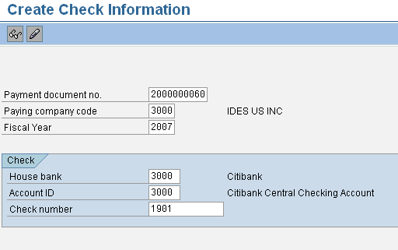
Check Management Transactions
Entering Manually-Created Checks in Check Management [FCH5]
Checks issued manually need to be dealt with separately in order to create a link between the check number and the payment document. In order to keep the use and management of manually created checks separate from those created automatically, a separate number range should be reserved for them
To enter manually created checks, proceed as follows from the Accounts Payable menu:
Post the outgoing payment (Document entry ➔ Outgoing payment)
Choose Environment ➔ Check information ➔ Create ➔ Manual checks. A screen is displayed for allocating the payment document number to the check number
Enter the required data and save your entries right away or, if you want to check the data first or you need to supplement it (with the name of the payee, for example), choose ENTER

Slide 47
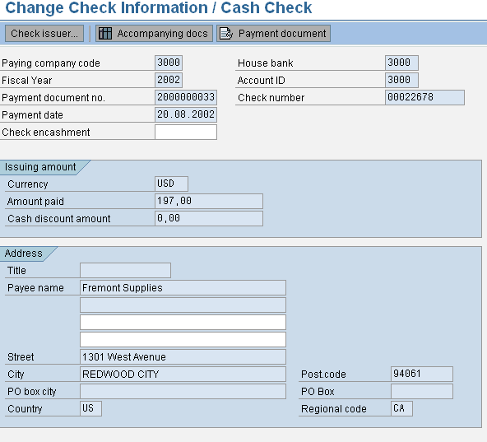
Supplementing Check Information / Cashing Individual Checks
The check management function allows you to enter brief information about a check such as the check recipient (when the check is made out to an individual) as well as the date the check was cashed
To do this, choose Environment ➔ Check information ➔ Change ➔ Additional info/cash. If you are processing manual checks, you can correct the data saved

Slide 48
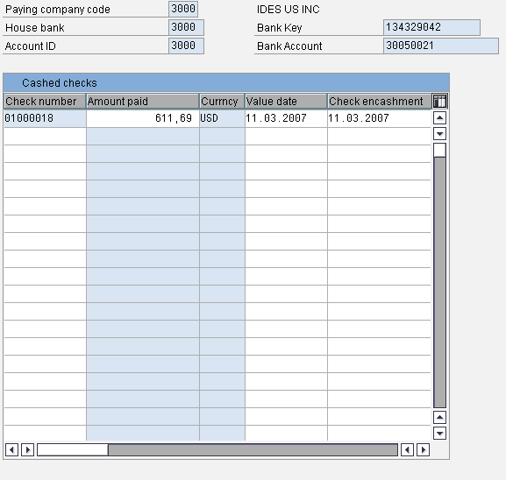
Cashed Checks [FCHR]
If your bank sends you information about your cashed checks by electronic means, for example in the form of a file on disk, you can import this data into your system using program RFEBCK00 (after first converting it to SAP format)
If you receive this information in list form, you can use the Manual cashed checks function to transfer the data. To do so, choose Environment ➔ Check information ➔ Change ➔ Online cashed checks. You can then enter the bank list in the system
In both of the above cases, postings are made from the outgoing checks account to the bank account. In addition, the date on which the check was cashed is recorded in the check information file

Slide 49
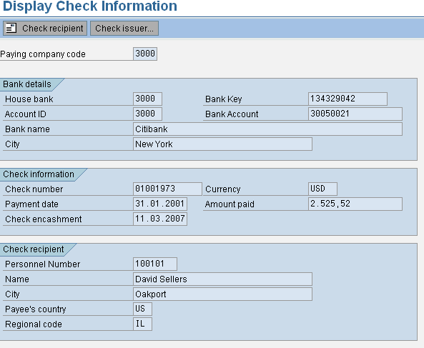
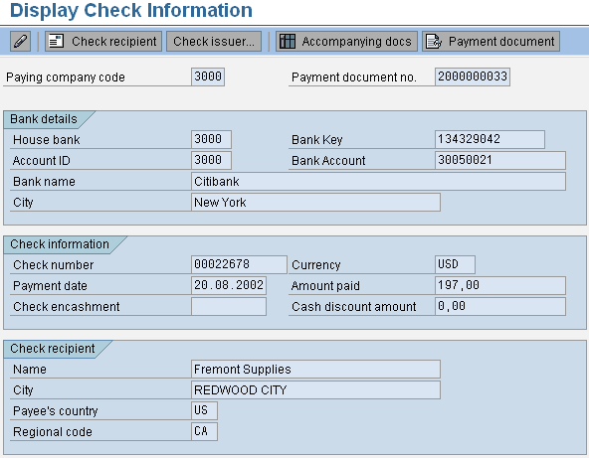
Displaying Check Information
You can display more detailed check information both via the check number and via the payment document number. To do this, proceed as follows from the Accounts Payable menu:
To display via the check number, choose: Environment ➔ Check information ➔ Display ➔ For check [FCH1]
To display via the payment document number, choose: Environment ➔ Check information ➔ Display ➔ For payment document [FCH2]
After entering the check number or the payment document number in question and choosing Enter, the system displays the check information
From the check information display, you can request details on the check recipient and the check issuer as well as branch to display of the corresponding payment and invoice documents
Conversely, you can also branch to the check information display from the invoice document display. To do this, proceed as follows:
Choose Document ➔ Display.
Enter the document number, company code, and fiscal year.
Choose Enter. The system displays an overview of the individual items
Select an item and choose Environment ➔ Check Information.

Slide 50
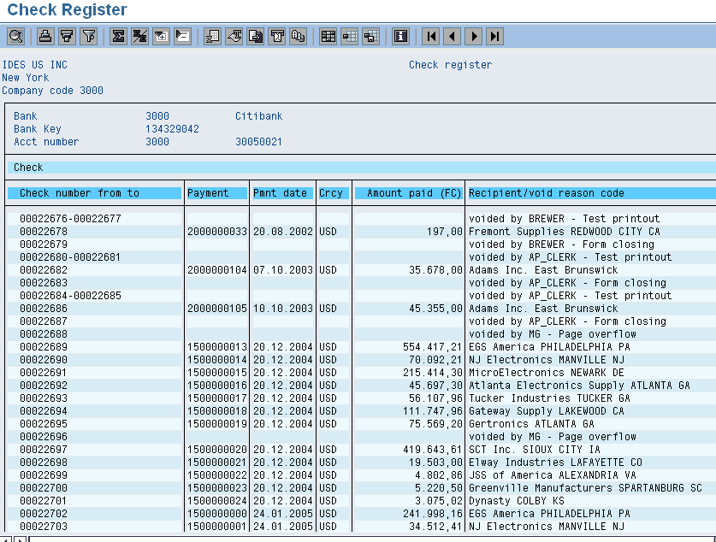
Displaying the Check Register
To obtain a full overview of all check information stored in the system, choose the following from the Accounts Payable menu: Environment ➔ Check information ➔ Display ➔ Check register.

Slide 51
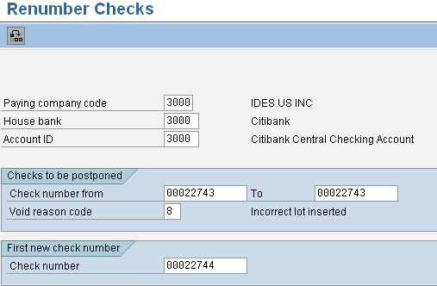
Check Management Problems: Renumbering Checks
It may be necessary to renumber the checks maintained in the system
During adjustment of the checks, more trial printouts were used than was anticipated. This is why the numbers of the used checks do not correspond with the numbers that were determined in the print run
Proceed as follows to renumber the check lot in question:
Choose Environment ➔ Check information ➔ Change ➔ Renumber
When the system displays the next screen, you enter the following values:
The number range to be shifted
Void reason code
First new check number
Choose Check ➔ Renumber

Slide 52
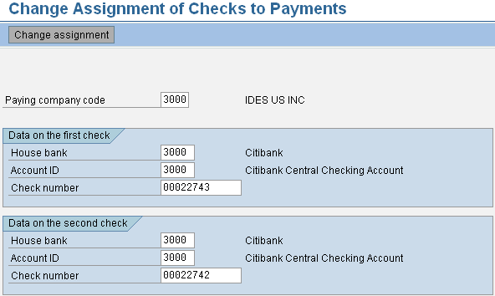
Reassigning Checks to Payments
If, for some reason, the numbered checks are assigned to the wrong payments (for example, because the checks were fed into the printer in the wrong order), you can reassign the checks to the correct payments before sending them out
To do this, proceed as follows from the Accounts Payable/Receivable menu: Environment ➔ Check information ➔ Change ➔ Assignment to payment

Slide 53
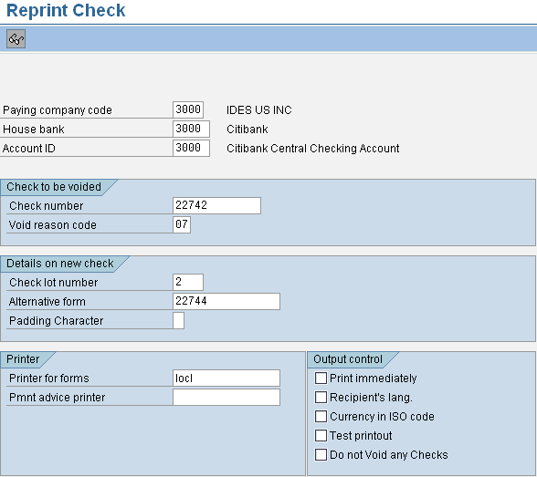
Reprinting Checks
If a check goes missing (say, it is lost in the post on its way to the recipient) or is rendered unusable for other reasons, you can reprint it
From the Accounts Payable menu, choose: Environment ➔ Check information ➔ Change ➔ Reprint check, or (if you only know the payment document number), Document ➔ Other functions ➔ Print payment form

Slide 54
Restart
If the printer stops during printing, for example because of a power failure, you will need to restart the print program
To do this, choose System ➔ Services ➔ Reporting
Enter the name of the print program (RFFOUS_C) and select Program ➔ Execute
Enter the data identifying the print run and enter the check number from which the program should be restarted in the Restart field
Select Program ➔ Execute again
If there is a system crash during the print run but before any checks have been printed, you should proceed as follows:
Correct the error that caused the system to crash
Delete the check information. To do this, choose Environment ➔ Check information ➔ Delete ➔ For payment run
Restart the print program but do not use the restart option described above
If there is a system crash during the print run and some checks have already been printed, you should proceed as follows:
Correct the error that caused the system to crash
This error may occur, for example, when a check lot is used up and the next lot has not been maintained. In this case, the first thing to do after the system crash is to enter a new check lot
Delete the check information. To do this, choose Environment ➔ Check information ➔ Delete ➔ For payment run
Restart the print program but do not use the restart option described above
Delete the print output from the print management files
Now restart the print program, this time using the restart option, (see above)

Slide 55
Voiding Checks
You can void checks both before and after they have been printed
Before the print run, you void blank checks that are accidentally damaged, or stolen or rendered unusable for any other reason. Proceed as follows:
Choose Environment ➔ Check information ➔ Void ➔ Unused checks
On the next screen, enter the check numbers in question and a key for the void reason code
Select Check ➔ Void
Checks that are voided after the print run, for example, are those that are not required due to cash payment being chosen instead of by check. To void printed checks, proceed as follows:
From the Accounts Payable/Receivable menu, choose Environment ➔ Check information ➔ Void ➔ Issued checks
In the next screen, enter the check numbers in question and a key for the void reason

Slide 56
Reversing a Check Payment
If it proves necessary to reverse all the cleared items after a check has been printed, choose Environment ➔ Check information ➔Void ➔ Cancel payment
You may need to do this if, for example, you have forgotten to block a check payment when processing the payment proposal, or if the wrong invoice was selected for the online check print
The check in question will be marked as void in the system, the payment document reversed and the invoices reopened for payment again

Slide 57
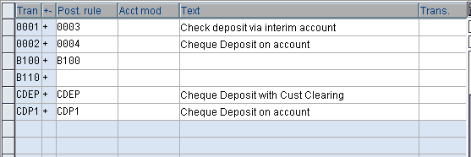
Check Deposit – Configuration
Create and Assign Business Transactions:
Here we store transaction indicators for check deposit and allocate these indicators to posting rule
Account modification is defined to post individual transactions to an different account than one provided by the posting method for the posting rule
Actions:
Define transaction indicator [this determines how and which account the system is to post the payment]
Allocate posting rule to each transaction indicator [this specifies the rule for posting to general ledger and sub ledger
If required, define account modification

Slide 58
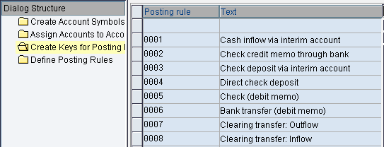
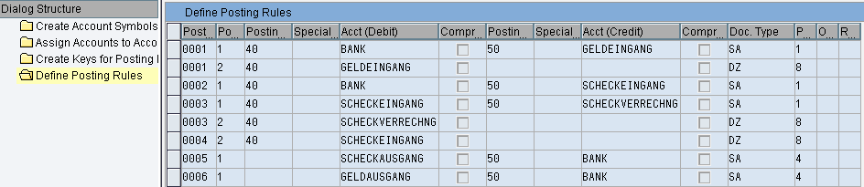
Define Posting keys and posting rules for check Deposit:
Here we define posting keys and posting rules for check deposit
Creating keys for posting rule:
Here we define posting rules for check deposit. The key determines the posting rules for general ledger sub ledger accounting

Slide 59
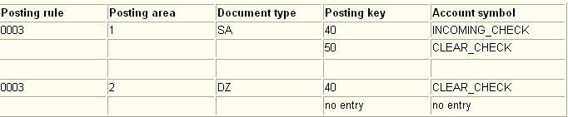
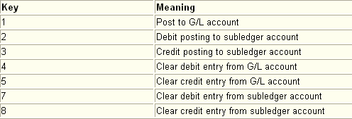
Example: Posting Check Deposits:
When making these specifications, you should note that you are not permitted to enter account symbols for sub ledger accounts, since these are determined either by the standard interpretation algorithm for finding clearing information or by functional enhancements.
You start by specifying a posting type for each set of posting specifications
You can choose from the posting types:
In example 1 the posting in posting area 1 would have posting type 1 (Post to G/L account) and the posting in posting area 2 would have posting type 8 (Clear credit entry from sub ledger account)

Slide 60
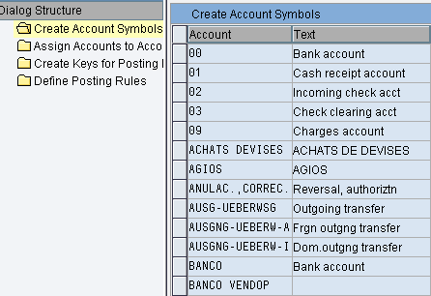
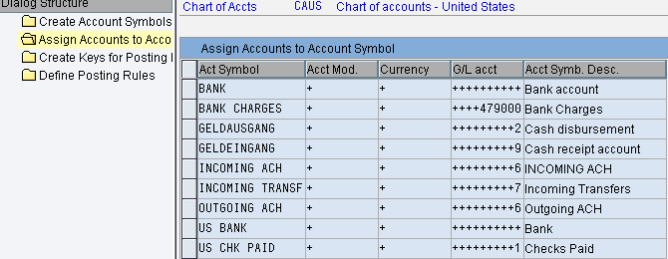
Account Symbols and Account Assignment
The account symbol is defined by the user during Customizing. It specifies which G/L account is posted to. You create the prerequisites for this when creating your house banks. Here you maintain the bank details and the accounts that you have at your house bank. You must create a G/L account in your system for each of these accounts
How can you be certain that specifying a certain account symbol leads to the G/L account you specified when maintaining your house bank accounts being posted to? The SAP R/3 System ensures that the correct account is posted to by replacing this account symbol with the appropriate account at the time of posting

Slide 61


Assigning G/L Accounts to Account Symbols
You can assign the G/L account to the account number in the following ways:
You can enter it in full:
You can enter the account number generically, i.e. by entering a series of "+" signs:
If you enter the number generically, the system replaces these plus signs with the G/L account number you maintained for your house bank (for example, 0000113100). You can enter the part of the account number and complete the field with "+" signs:
In this case too the system replaces these plus signs with the G/L account number you maintained for your house bank, but the non-generic part of your entry remains in the field. Again, taking the example of account 0000113100 (as defined in the house bank master), the two end digits of the number are replaced by "02". This entry would trigger a posting to account 0000113102

Slide 62
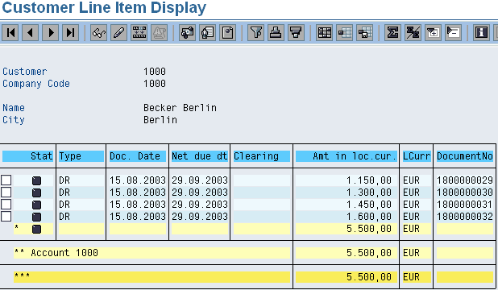
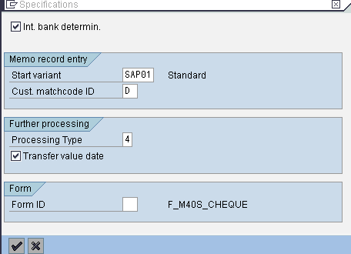
Check Deposit - Transactions
1
Posting Example:
Review the open items of the Customer
Go to transaction FF68 [Banks ➔ Input ➔ Check Deposit ➔ Manual entry] and enter the specifications as shown. Processing type chosen here is 4 i.e. Online processing
On next screen enter the data as shown i.e. check deposit list
On the next screen edit the check list by giving amount and document number. Here we can choose other variant by view ➔ other account assignment and enter the other details. To enter several values in an account assignment field (for example document no., invoice amount), select Edit ➔ Value set
Choose Check deposit trans ➔ Save
2

Slide 63
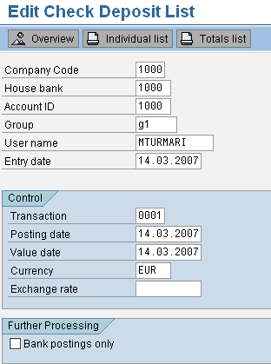
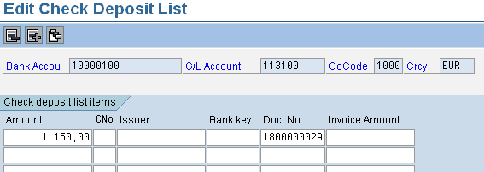
3
The system displays the screen with the basic data again
After you save the transaction, the system stores the check deposit list in the database but does not post it yet. You can change the list as long as it has not been posted yet. After the posting process has been started, you cannot make any changes
To make changes to a list not posted yet, branch from the basic data screen to the entry screen by choosing Enter
Check deposit lists created in the current work session can be posted either separately or all at once. To post your incoming checks, go to the basic data screen and choose Check deposit trans. ➔ Post ➔ Individual list or All processed lists
Review the update account statement / check deposit transaction. The screen shot attached
Review the customer account statement. The screen shot attached
Review the documents posted. The screen shot attached
4

Slide 64
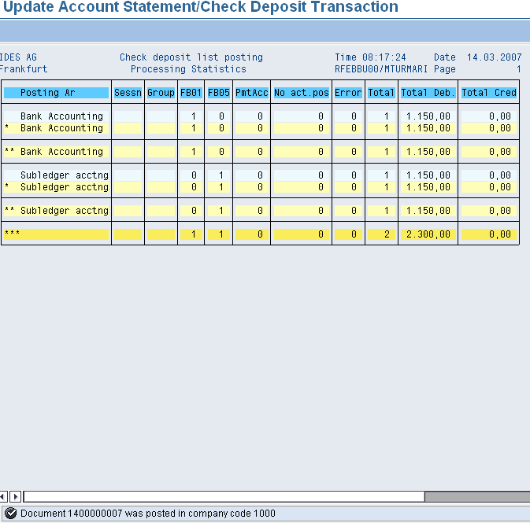
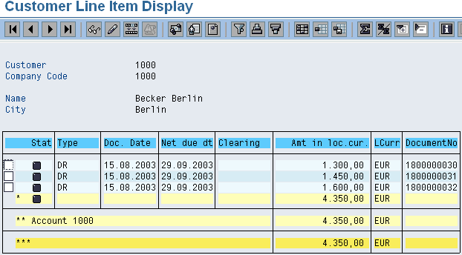
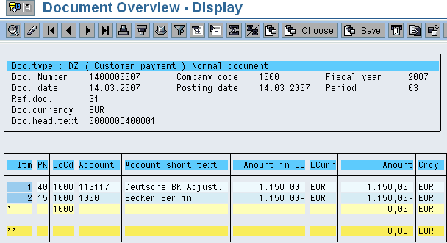
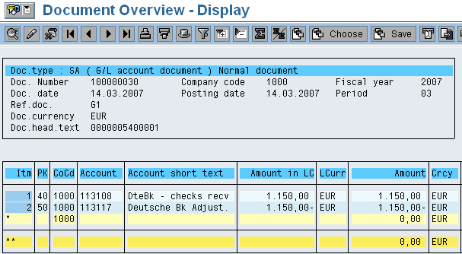
5
6
7
8

Slide 65
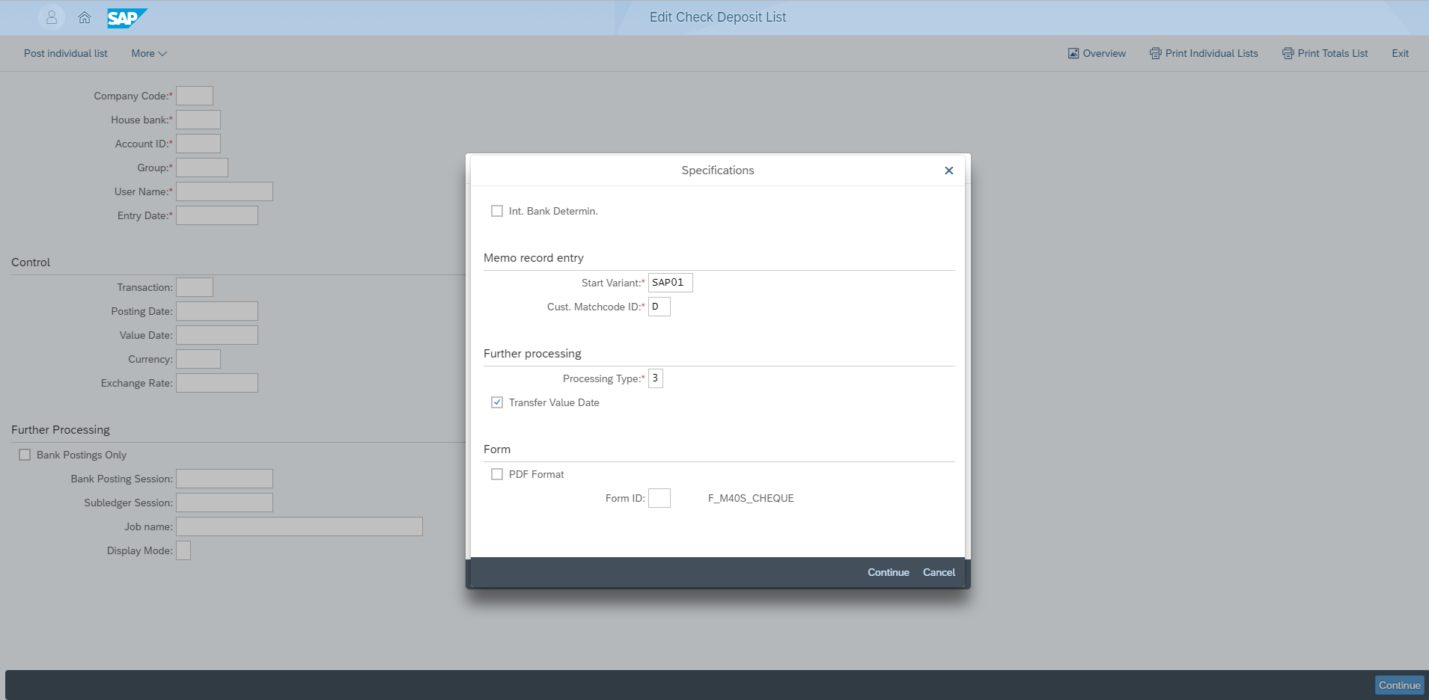
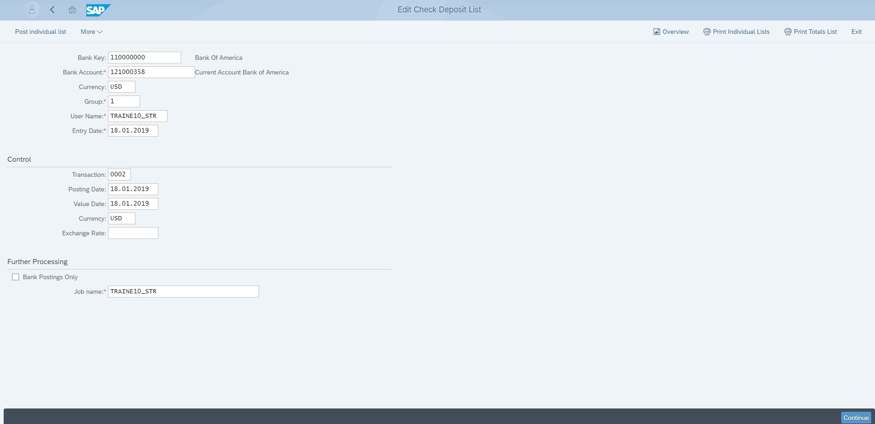
Manage Check Deposits
1. Enter Variant
2. Enter Processing Type
3. Click “Continue” Button
8. Select Entry Date
4. Enter Bank Key
5. Enter Bank Account Number
6. Enter Currency
7. Select Group
9. Select Transaction ID
10. Click “Continue” Button

Slide 66
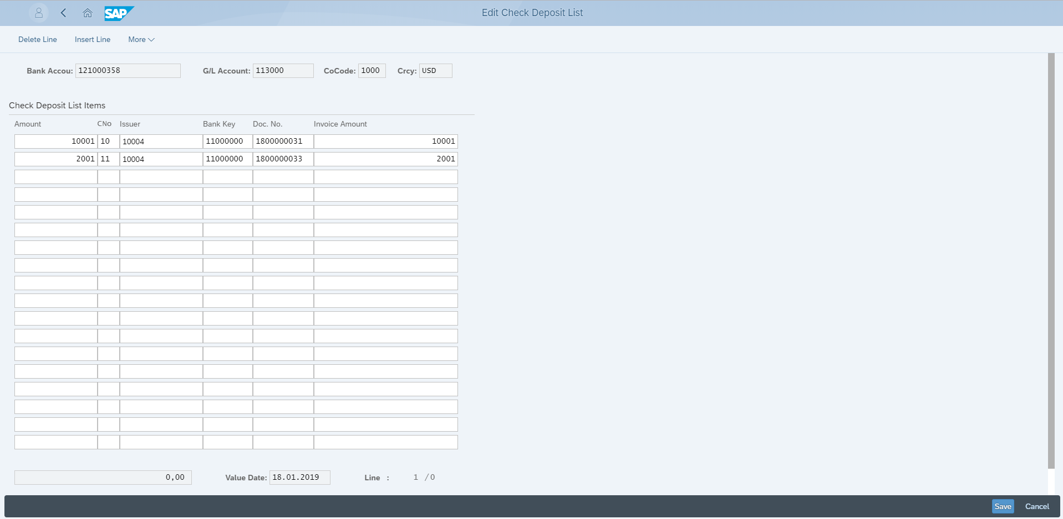
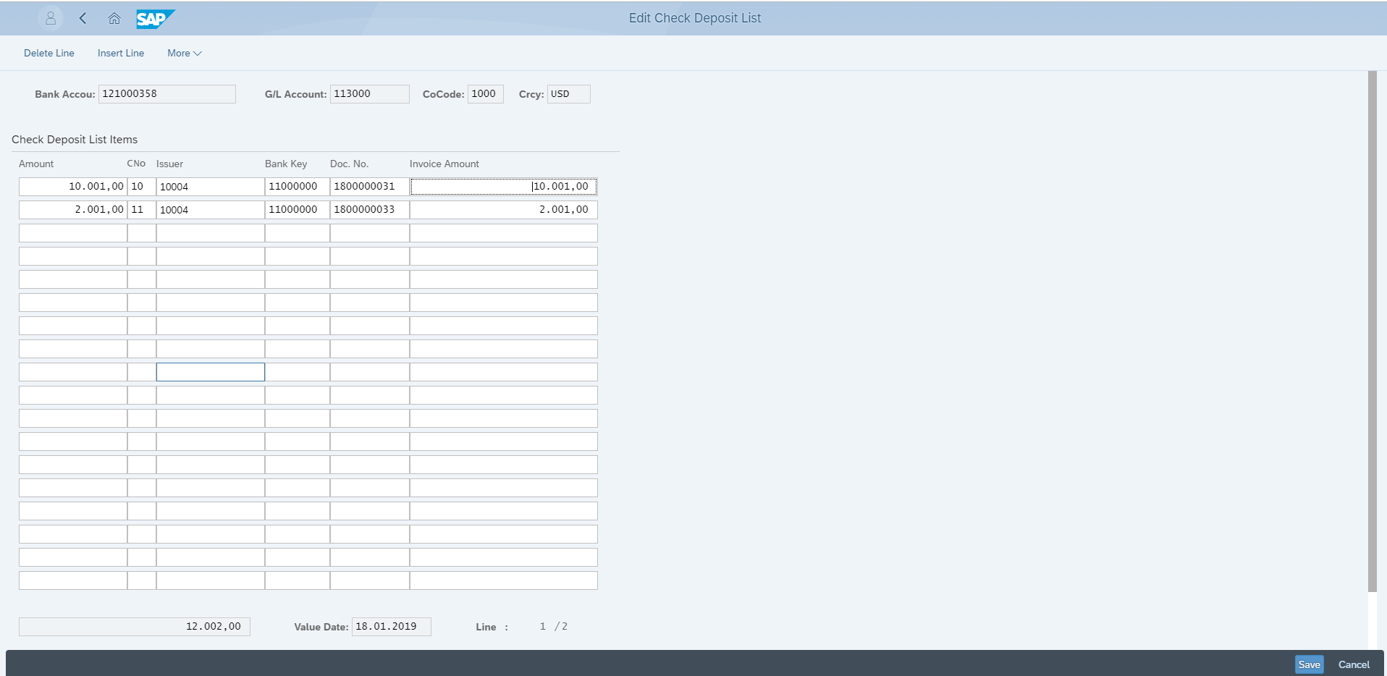
Manage Check Deposits
15. Enter Invoice Doc No
14. Enter Bank Key
13. Enter Issuer ID
12. Enter Chq. No
16. Click ”save” Icon
11. Enter Variant
17. Click ”Continue” Icon
18. Total Cheq. Amount Displayed

Slide 67
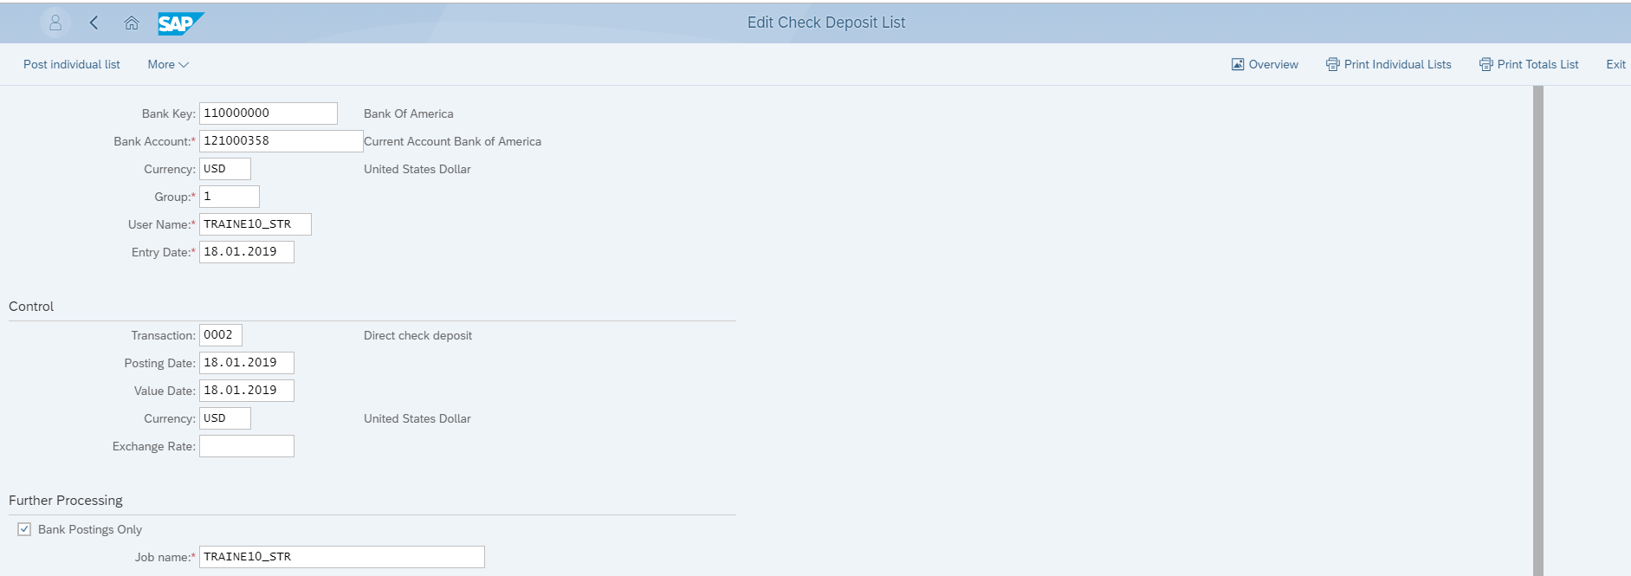
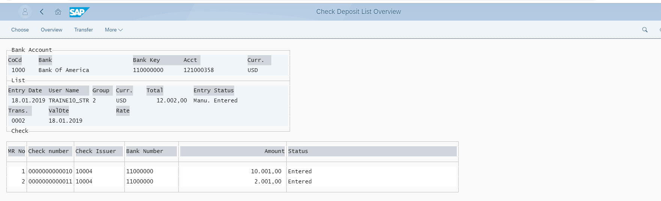
Manage Check Deposits
19. Select Over View Button
20. Check Deposit Statement Displayed

Slide 68
Posting Incoming Checks in batch input session:
Check deposit lists created in the current work session can be posted either separately or all at once. To post your incoming checks, go to the basic data screen and choose Check deposit trans. ➔ Post ➔ Individual list or All processed lists
The system then displays a posting log with the batch input session names
If the program creates the session names, they consist of the house bank ID and the account ID. The sub ledger session name always starts with the special character "/"
The log shows how many bank postings and clearing postings were made and whether any errors occurred
Displaying the Overview and Processing Status:
By using the overview list, you can obtain an overall view of your check deposit transactions. The overview contains the following data:
Entry date
User name
Group name
Company code and currency
Total amount
Processing status

Slide 69
The processing status shows to what extent your incoming checks have been posted. If both bank postings and clearing postings have been made, the "posting complete" status is displayed. If only postings to bank accounts have been made, the "posting incomplete" status is displayed. If no postings have been made, the "entered" status is displayed
To create this overview, proceed as follows.
From the basic data screen, select Check deposit trans. ➔ Lists overview
Use F2 to select the check deposit lists for a specific bank
The system displays an overview of all check deposit lists
To display the status of memo records, select a specific list with F2
If you created only a session for bank postings first, you can, if necessary, branch again to the screen for maintaining the check deposit list when you need to enter the clearing information. The required account assignment fields (for example document number, drawer) are then ready for input
By choosing Copy, you can branch from the overview screen to the screen for processing the check deposit list. Choose ENTER in this screen to reach the maintenance and display screen

Slide 70
Processing the Batch Input Sessions
After creating the batch input sessions, you must process them. To do this, proceed as follows:
Choose System ➔ Services ➔ Batch input ➔ Edit
Specify the name of the session you want to process, and confirm
Choose Session ➔ Process
The system displays a dialog box in which you specify whether it should process the sessions in the foreground or background or whether it should display only errors that may occur
Choose Process in the dialog box
The system displays a message saying that one session has been transferred to batch processing
Check whether the batch input has been processed without any errors by choosing Go to ➔ Log
The processing statistics at the end of the log show how many read transactions could be processed or are incorrect
You can post process the memo records that were not processed because of missing clearing information. To do this, you must rerun the batch input session in the foreground. Proceed as follows.
Choose Session ➔ Process
In the dialog box, select Process in foreground
In the screens that follow, enter the information required for clearing the open items

Slide 71
Manual Bank Statement: Procedure

Slide 72
Entering the Bank Statement
The start variant specifies the account assignment variant for the individual postings
The match code ID and the further processing type determine whether the postings in the batch input session are made online or in the background
If you select internal bank determination, the system identifies the bank using the internal identification (house bank, bank account key) you specify on the next screen

Slide 73
Processing the Bank Statement (1): Bank & Payment Advices
House bank or bank account ID: Here you enter the cash management account name (for internal bank determination)
Selection of payment advices: You can select the payment advices entered for the bank statement using various criteria
You can also enter the session names for further processing

Slide 74
Processing the Bank Statement (2): Bank Document / Selection
You use the transaction to control which type of bank posting you are processing, for example, credit memo, wire transfer or check payment. Transaction types are freely definable in customizing
Individual documents are selected in sub ledger accounting by using certain criteria (such as the document number) or by using the match code (account determination) and additional information (document determination) such as the amount, allocation, posting date or document date. The selection fields the system displays depend on the account assignment variant and interpretation algorithm you are using

Slide 75
Processing the Bank Statement (3): Further Processing
Bank statements you enter can be displayed, changed, or deleted before posting
The ”Post” option generates the batch input sessions required for the bank account postings and sub ledger account postings (postings cannot be made twice)

Slide 76
Manual Bank Statement Posting: Examples

Slide 77
Manual Bank Statement Posting: Examples

Slide 78
Manual Bank Statement Posting: Examples

Slide 79
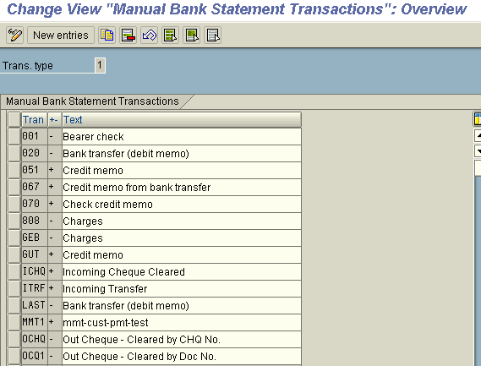
Manual Bank Statement – Configuration
Create and Assign Business Transactions
IMG ➔ Financial accounting(New) ➔ Bank accounting ➔ Business transactions ➔ payment transactions ➔ Manual Bank statement]
In this step you store an indicator for each business transaction and allocate a posting rule to each business transaction. Several business transactions usually refer to the same posting rule
Interpretation algorithm: This enables you to find separate outgoing payments using the reference information returned by the bank
Actions
Assign a transaction key to each business transaction
Allocate a posting rule to each business transaction
Set up an account modification for those transactions that should not be posted to the standard account

Slide 80
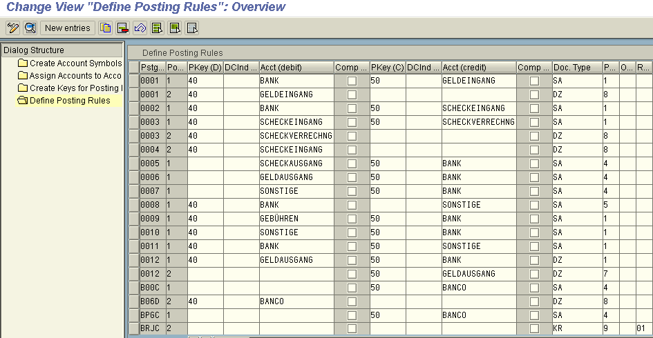
Define Posting Keys & Posting Rules for Manual Bank Statement
This configuration is same as that of Check deposit. For details refer the same

Slide 81


Define Variants for Manual Bank Statement
In this step you can create separate account assignment variants for the manual bank statement in order to adapt the arrangement and/or the selection of account assignment fields to your company-specific requirements
One variant is delivered as a default. It cannot be modified
If you do not want to work with the standard variant, you can deactivate it. New variants must be activated after you create them

Slide 82
Manual Bank statement – Transaction
Review the Bank statement items to be posted and the corresponding open items in system
Enter the transaction FF67 [Banks ➔ Input ➔ Bank statement ➔ Manual entry
Enter the specifications as shown
Enter the processing parameters for manual bank statement as shown. Ensure that the opening balance of the bank statement to be posted matches with closing balance of the last statement in the system. The last closing balance can be obtained from the manual bank statement overview
On the next screen edit the check list by giving amount and document number. Here we can choose other variant by view ➔ other account assignment and enter the other details. To enter several values in an account assignment field (for example document no., invoice amount), select Edit ➔ Value set. Save the bank statement edited
To post the bank statement choose Bank statement ➔ post ➔ individual statement. Review the update account statement / check deposit transaction. Check if there are any errors. Review the documents posted

Slide 83
In case of errors [as shown in this case] go to bank statement overview and to particular bank statement items with the status incomplete. After reviewing the same go to transaction FEBA i.e. post processing
Edit the item in which you carry out, for example, the following activities:
Change posting rule
Block item
Change customer
Delete payment advice note
To change the posting mode, choose Edit ➔ Change Posting Mode ➔ Online (In the Background, if Error Online)
To post the item, choose Edit ➔ Post Statement Items
The note to payee is still visible in a separate window
You make changes to the account assignment or select missing open items on the posting transaction screens. The note to payee displayed separately provides you with the required information. Review the documents posted
In the example shown the system could not carry on the posting earlier as there were two open items with same document number belonging to different fiscal years. The correct open item is selected in posting transaction screen

Slide 84




1
2
3
4

Slide 85




5
6
7
8

Slide 86




9
10
11
12

Slide 87


13
14

Slide 88


Manage Bank Statements
1.Click “Go” Icon
2.Click “+” Icon for Create Bank Statement
3.Select House Bank ID
4.Specify Bank Statement No
5.Specify Amount
7.Select House Bank ID
6.Select Bank Statement Date
8.Select Transaction ID
9.Specify Transaction Amount
10.Click “>” Button

Slide 89


Manage Bank Statements
11. Select value Date
13. Click “Apply "Button
12. Select GL Account
14. Successfully Bank statement Generated

Slide 90
Electronic Bank Statement: Features (1)

Slide 91
Electronic Bank Statement: Features (2)

Slide 92
Electronic Bank Statements – New Formats Supported

Slide 93
Interpreting the Note to Payee

Slide 94
Electronic Bank Statement

Slide 95
Electronic Bank Statement: Printout

Slide 96
Electronic Bank Statement: Postprocessing

Slide 97


Electronic Bank Statement – Configuration
Path : IMG ➔ Financial Accounting (New)➔ Bank accounting ➔ Business transactions ➔ Payment transactions ➔ Electronic Bank statement
Make Global Settings for Electronic Bank Statement:
Create Transaction Types:
You define transaction types in order to group together banks with the same external transaction codes (for example, all banks of the same type)
After defining transaction types you must assign each of your house banks to a transaction type
Assign Bank Accounts to Transaction Types:
You assign each of your house banks to a transaction type in Customizing for Bank Accounting. Banks are identified by specifying bank keys and external account numbers

Slide 98

Creating Keys for Posting Rules
You create posting rules in Customizing for Bank Accounting. Posting rules are represented in the system by a non-bank-specific code (for example, 0001 for debit memos). Banks have many different transactions, several of which may require just a single posting in your accounts
Assign External transactions to posting rules:
Here you assign the external bank-defined transaction codes to system-internal posting rules for each transaction type
The +/- sign: You can further differentiate external transactions by setting "+" or "-" signs for them. If the external transaction code has a "+" sign in front of it, it is a cash receipt; likewise, a "-" sign represents a cash disbursement

Slide 99


The interpretation algorithm:
In addition to specifying posting rules, you must also specify which interpretation algorithm should be used. The interpretation algorithm determines whether (and with which algorithms) the system should search the note to payee lines of the electronic account statement for clearing information
Interpreting the Note to Payee Fields:
The note to payee fields in the electronic account statement contain information used to clear open items. The information such as document number, reference document number, check number may be included in electronic bank statement. The interpretation algorithm allows you to search for your own incoming and outgoing payments in the account statement, based on information supplied by your customers and/or your house bank and entered in the note to payee lines in the account statement

Slide 100

Defining Posting Rules
You define posting rules in Customizing for Bank Accounting.
In this activity you carry out the following:
You create the account symbols for the required posting transactions
You define the account determination rules for each of the account symbols
You create posting specifications for postings to G/L or bank accounts (posting area 1) and sub ledger postings (posting area 2) for those of the posting transactions you choose

Slide 101
Electronic Bank Statement – Transactions
Importing the Account Statement:
Before importing account statements into the SAP R/3 System, you must first retrieve them from the banks
Normally, you receive the statement files by means of banking communication software (BCS), which calls the bank and retrieves the files. Banks in almost all countries sell these PC programs and provide training for them
The import procedure can be carried out only once the account statement files are accessible on your file system or PC drive
The system supports over 16 international formats for the electronic account statement. Before importing files, R/3’s standard program converts some of the account statement files to MultiCash format
For the SWIFT format, there are dialects that differ from the standard SWIFT. The SAP R/3 System does not support these dialects. SAP does however certify the SWIFT MT940 interface (FI-SBS). Certified banks or software providers can supply you with SWIFT MT940 files that can be processed

Slide 102
Executing the Program:
Use program RFEBKA00 to import files containing account statement data
To run the program, proceed as follows: From the easy access screen, choose Accounting ➔ Financial Accounting ➔ Banks ➔ Input ➔ Account Statement ➔ Import
Enter the information necessary in the entry areas in the active fields
File specifications:
Importing the file: Select the option Import data. Set this indicator to transfer the account statement from the file system to SAP bank data storage. If you start the import program without setting this indicator, the system will try to process all the account statements already in bank data storage. For this reason, make sure that bank data storage contains only actual data and no test data.
Elect. bank statement format: Here you specify the format in which the account statements are to be imported. Normally, this is either the format M(ulticash) or S(wift MT 940).
Statement file: Enter the name of the file containing the statement data and the file path. When importing from a PC (hard drive or disk drive) you must also specify the drive (for example, A: Line item file).
Line item file: Enter the path and the name of the file containing the line item data. You can only make an entry in this field if you are using the MultiCash format. This field is not required for any other format.
PC upload: Select this option if you are using a PC and want to import the file from the disk drive or hard drive. Note that this option is not possible if you have selected the option Execute as Batchjob.

Slide 103
Posting Parameters
Post immediately: Select this indicator to have the program post the data immediately (call transaction). Note that you must select this option to be able to use the postprocessing transaction for the electronic account statement
Bank accounts only: If you select this indicator, the system initially posts only to posting area 1 (General Ledger or Bank Accounting) during account statement importing (defined in each case by the posting specifications). The postings for posting area 2 are not made at this stage and can be performed at a later date
Generate batch input: To generate batch input sessions, select this option. At the same time, you can update the line items to the G/L and subsidiary ledger accounts. To do this, the system creates two batch input sessions:
Bank accounting & Subledger accounting. Both sessions are created in the course of one run
Once a transaction is included in a session, it is considered to be posted
Session names: This option is not effective if the indicator Post immediately is selected. Enter a number that specifies how the session name is to be generated. The default setting is 1, meaning that the session name consists of the house bank ID and account ID. This applies both to the bank posting session and the subledger posting session, the only difference being that the first character in the name of the subledger posting session is a "/"
Do not post: If you select this indicator, no postings are generated. The data is loaded into bank data storage and held there. The posting log lists the postings that would have been placed in the batch input sessions during a production run. We recommend that you set this indicator during a test phase
Assign value date to account If you select this option, the system uses the value date during posting

Slide 104
Algorithms
Number interval: Here, you specify the intervals within which the values of your document numbers and/or reference document numbers can lie. The program ignores values not contained within these intervals. They cannot be used as information to clear open items. The reference number entered in the account statement by your customer or house bank must be in the same format and of the same length as the number in the R/3 System
You send your customer a bank transfer form with the reference document number 000101. However, the customer only forwards the last three digits of this number on to your house bank. The number (101) then appears on the electronic bank statement too. The system is unable to locate this number. For this reason, it is essential that customers and house banks do not omit leading zeroes from such forms when processing electronic bank statements
Bundling: You can use this field to determine whether and if so how bank statement items should be grouped into bundles. If you have the program post the bank statements immediately (call transaction), you can select the items of a bank statement in the postprocessing function by bundle. If you use batch input sessions, you can generate a separate session for each bundle
Under bundle type 1 (bundle per accounting clerk), the system enters the accounting clerk ID from the customer master record into the field. If the customer cannot be uniquely identified from the bank details, the field remains blank
Under bundle type 2, the system creates a bundle per n items, enabling up to 99 bundles to be created. If you enter n = 100, the first 100 line items are contained in bundle 1, the next 100 items in bundle 2 and so on. If you enter n = 1, line items 1 to 99 are entered in bundles 1 to 99. The 100th line item is then entered starting once again from bundle 1

Slide 105
The following parameters control how the data is output:
Execute as background job
Print bank statement
Print posting log
Print statistics
Separate list
Data Output Options
To print the posting log and posting statistics separately, select Separate list.

Slide 106
Displaying Account Statements
You can display the account statements found in the bank data memory at any time. To select the account statements for display, you can enter the following information:
Company code
House bank ID
Bank account ID
Statement number
Statement date
External transaction code
Posting rule
Bundle number
Amount
The ID is information that is not transmitted with the account statement. Each account statement is assigned a unique number in the SAP R/3 System. This is referred to as the ID
The ID is internally assigned by the system
To display the overview, proceed as follows:
Select Accounting ➔ Financial Accounting ➔ Banks ➔ Input ➔ Account statement ➔ Display
On the screen that is now displayed, access the country-specific program
Enter your selection parameters on the next screen
Select Program ➔ Execute

Slide 107
Post Processing Account Statements
You have the following options for postprocessing electronic account statements. You choose these in the bank account import selection screen
Post immediately (call transaction)
Generate batch input
The type of processing you choose at this point determines what type of postprocessing you can use for the electronic account statement
If you selected the Post immediately parameter when importing the account statement, you can use a postprocessing transaction to modify and then post line items that the system has not automatically posted
The advantage of this option is that each document number posted as a result of the electronic account statement is saved in bank data storage. You can then determine the status of a posting
In the document display of the bank statement that you have posted with posting parameter Post Immediately you can display the line items that relate to the bank statement. To do this choose Services for Object → Links
This is not possible in batch input processing because the statement data is not posted until the sessions are processed. Only then can you obtain information on whether or not a posting was made successfully
As a rule, the sessions are first processed in the background. The result is recorded in the batch input log. Transactions not updated remain in the session as defective records. The sessions are then postprocessed in the folder “online”. You can change or delete defective data or add any that was missing. Postprocessing is complete when there are no more defective records in a session
Since the system assumes that the postings in a session will eventually be made successfully, it indicates that the line items of the account statement are “posted successfully”
An additional advantage is the extra options provided by the postprocessing transaction. You can for example change the postings rules later or edit the payment advice notes (not to be confused with the cash management payment advice notes)

Slide 108
Standard Reports
FF_6 – Display [Financial accounting ➔ Banks ➔ Input ➔ Bank statement
With this you can print out any of the bank statements in the bank data buffer
S_P99_41000166 - Display Bank Directory [Banks ➔ Master data ➔ Bank Mater record]
This report lists banks and their master data
S_P00_07000008 - Display of Bank Changes [Banks ➔ Master data ➔ Bank Mater record]
This report lists the changes to bank master data for all the bank accounts
S_ALR_87012348 - Cashed Checks per Bank Account [Banks ➔ Information system]
The report gives the average period outstanding for the checks already cashed and checks outstanding. It also gives the number and total amount of checks currently outstanding
S_ALR_87012349 - Outstanding Checks Analysis per G/L Account and Vendor [Banks ➔ Information system]
Using this, you can display the outstanding period, that is difference between cashing date and posting date for each GL account managed on OI basis for each vendor

